Slide 1

KS3 Mathematics
N2 Adding and Subtracting Integers
Notes:
The aim of this unit is to teach pupils to:
Order, add, subtract, multiply and divide positive and negative numbers.
Material in this unit is linked to the Key Stage 3 Framework supplement of examples pp 48-51.

Slide 2

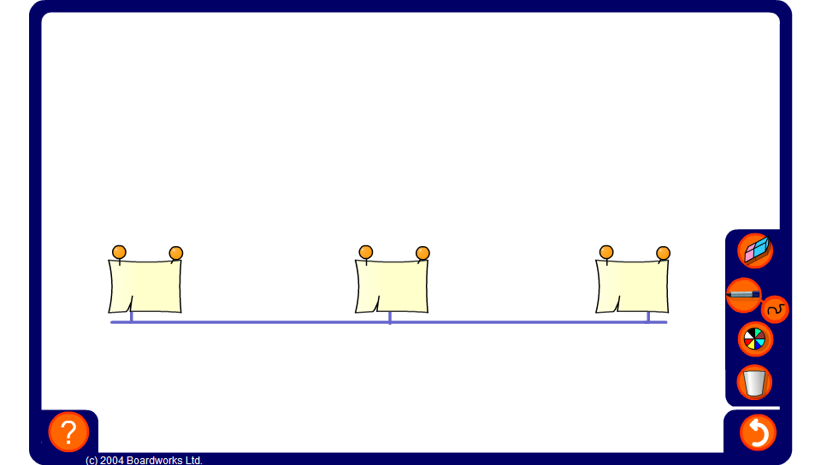


Mid-points
Notes:
Explain to pupils that we wish to find the number that is exactly half-way between the other two. Reveal all three numbers as an example.
Generate a new example and reveal the two end-points. Ask pupils to justify their answers. Vary the activity by revealing the mid-point and one of the end-points.
As an extension include negative decimals.
Links:
N1 Place value, ordering and rounding - ordering decimals.
D3 Representing and interpreting data – calculating the mean

Slide 3


Adding integers
We can use a number line to help us add positive and negative integers.
–2 + 5 =
= 3
-2
3
To add a positive integer we move forwards up the number line.
Notes:
How can we use the number line to work out –2 + 5?
Start at –2 (click to highlight the –2 on the number line) and count forwards 5.
On a number line we move to the right for forwards (in a positive direction) and to the left for backwards (in a negative direction).
Explain that the answer can be positive or negative depending on the starting point. It is important to stress this fact because when pupils learn the rules for multiplying and dividing negative numbers they often confuse these rules for the rules for addition and subtraction.

Slide 4
Adding integers
We can use a number line to help us add positive and negative integers.
–3 + –4 =
= –7
-7
-3
To add a negative integer we move backwards down the number line.
–3 + –4
is the same as
–3 – 4
Notes:
How can we use the number line to work out –3 + -4?
Explain that when we add a negative number we have to move backwards down the number line. The answer can be positive or negative depending on the starting point.
Stress that adding a negative number is equivalent to subtracting the positive value of that number.

Slide 5
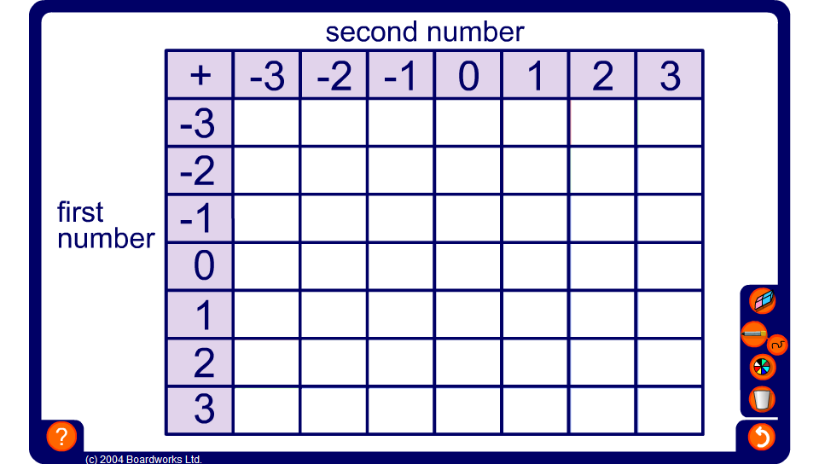
Ordered addition square
Notes:
This addition square can be used to draw the pupils’ attention to the number patterns produced when adding positive and negative integers in order.
Start by working out the positive number additions 3 + 0, 3 + 1, 3 + 2 and 3 + 3.
Ask pupils the answer to 3 + –1, using the number pattern in the table. Fill in the rest of the row to 3 + –3.
Repeat in the same order for the next three rows.
For the last three rows fill in the first answer by looking at the pattern in the first column and continue along the row.
Before revealing each answer ensure that the question corresponding to that cell has been clearly stated. For example,
What is 1 + –2?
Pupils may then look for number patterns to deduce the answer.
Once the table is complete, ask pupils to use the table to answer some given questions.
For example,
Use the table to work out –2 + 1.

Slide 6

Mixed addition square
Notes:
Work out the numbers in the empty squares by adding and subtracting.
Ask pupils why we do not need to label the sides of the square ‘first number’ and ‘second number’ (it makes no difference if we add 3 + 7 or 7 + 3).

Slide 7
Subtracting integers
We can use a number line to help us subtract positive and negative integers.
5 – 8 =
= –3
-3
5
To subtract a positive integer we move backwards down the number line.
Notes:
How can we use the number line to work out 5 – 8?
Start at 5 (click to make the 5 orange) and count backwards 8.

Slide 8
Subtracting integers
We can use a number line to help us subtract positive and negative integers.
3 – –6 =
= 9
3
9
To subtract a negative integer we move forwards up the number line.
3 – –6
is the same as
3 + 6
Notes:
How can we use the number line to work out 3 – –6?
Many pupils may find this difficult to understand. Explain what is happening.
When we subtract 6 we move backwards down the number line, so, when we subtract -6 we we need to move forwards up the number line.
“3 – –6 is equivalent to 3 + 6”
Yow may wish to give further examples of double negatives being equivalent to positives.

Slide 9
Subtracting integers
We can use a number line to help us subtract positive and negative integers.
–4 – –7 =
= 3
-4
3
To subtract a negative integers we move forwards up the number line.
–4 – –7
is the same as
–4 + 7
Notes:
Here is another example of subtracting a negative number.
Again, explain carefully that subtracting a negative number is equivalent to adding.
In this example, –4 is the starting point and then we move 7 forwards up the number line.
Ask pupils to tell you the equivalent calculation before revealing it on the board.

Slide 10
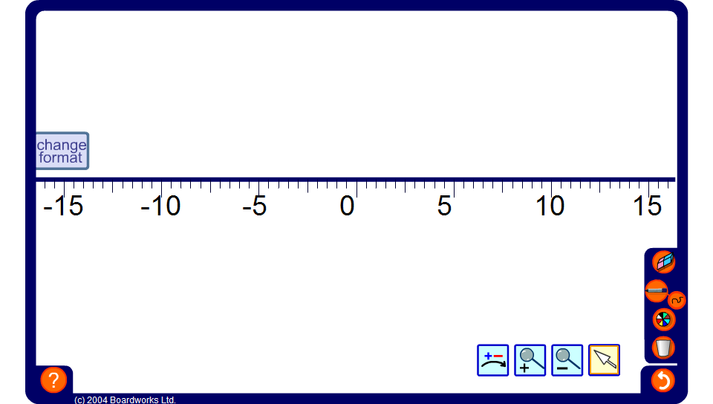
Using a number line
Notes:
Use the interactive number line to demonstrate a variety of addition and subtraction calculations.
Ask volunteers to come to the board to demonstrate solutions to problems using the number line.
Include problems with several small numbers such as 3 – 7 + 1 – –5.

Slide 11
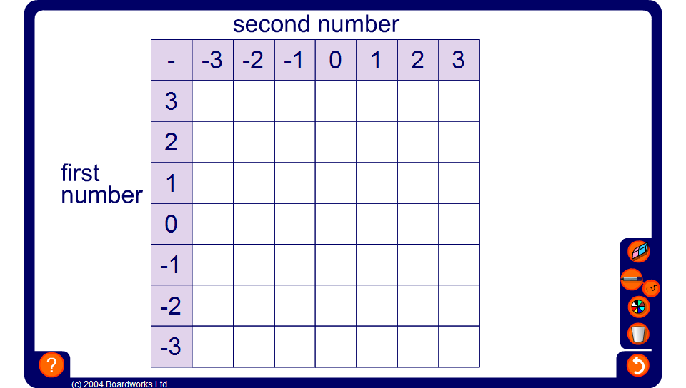
Ordered subtraction square
Notes:
This ordered subtraction square can be used to draw the pupils’ attention to the number patterns produced when subtracting positive and negative integers in order.
Point out that we are subtracting the integers across the top from the integers down the side.
Clicking on a cell will reveal the number inside it.
Start by revealing the cells on the far right and moving in order along the row to the left. Alternatively, make the activity more difficult by revealing the cells in random order.
Once the table is complete, ask pupils to use it to answer some given questions.
For example,
Use the table to work out –1 – –3.

Slide 12
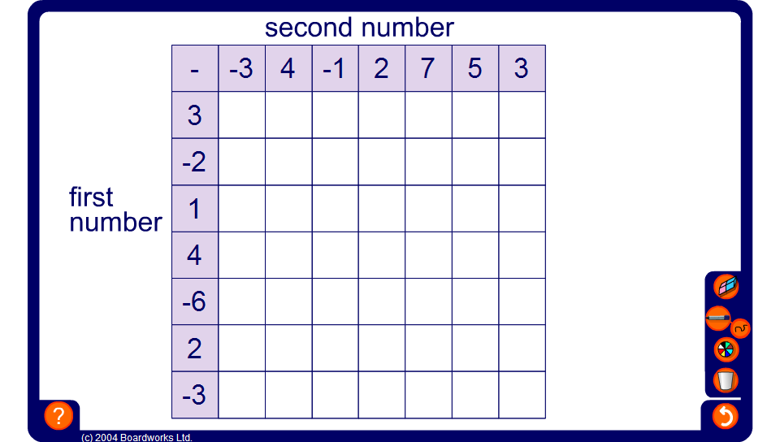
Mixed subtraction square
Notes:
Work out the numbers in the empty squares by adding and subtracting.

Slide 13

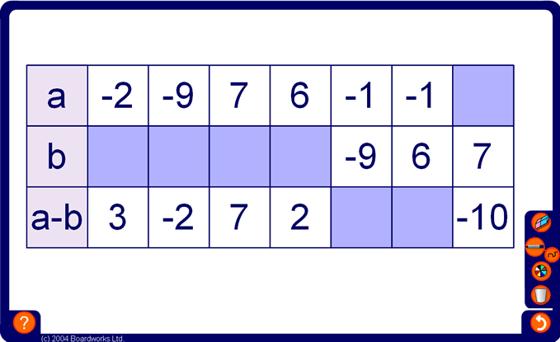
Complete this table
Notes:
This exercise may be completed orally as a class. Alternatively, give pupils a time limit to complete the task in writing before going through the answers.

Slide 14
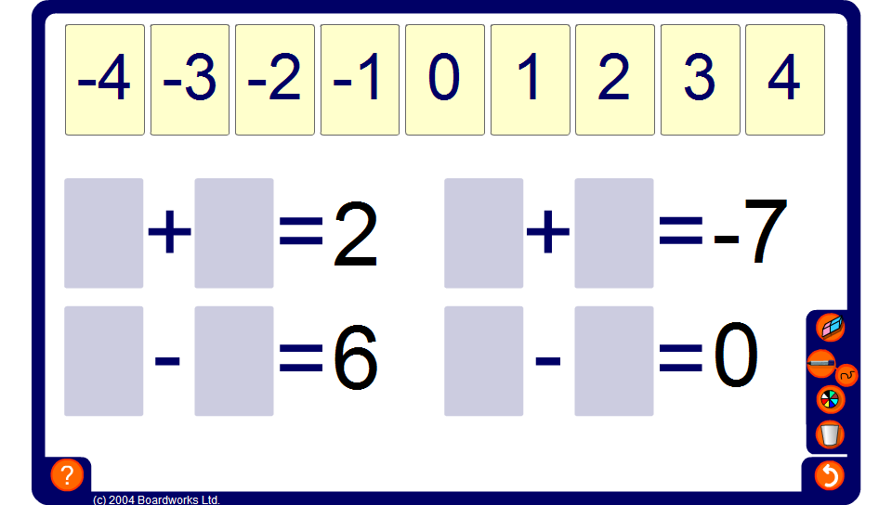
Integer cards - addition and subtraction
Notes:
Ask volunteers to come to the board to show a solution for each calculation. Tell them that each example must include at least one negative integer card.
Discuss all possible solutions for each calculation and ask pupils to tell you any patterns or relationships that they notice.

Slide 15
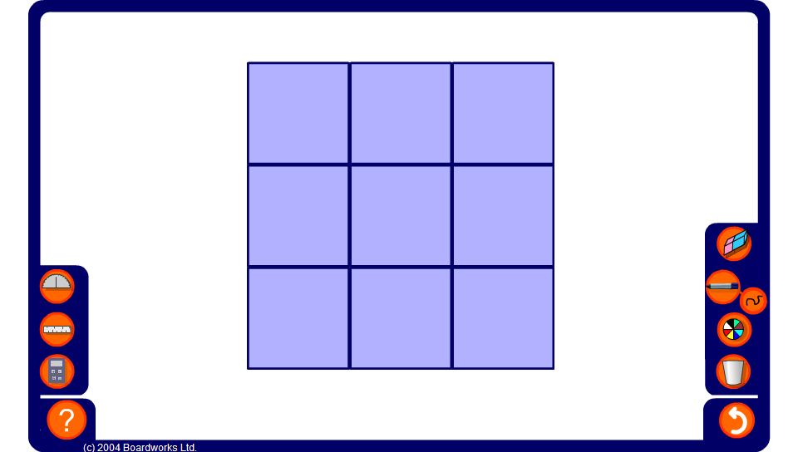
Magic Square
Notes:
Explain that in a magic square, each row, column and diagonal adds up to the same number.
Start by finding the ‘magic total’, that is the sum of each row, column and diagonal.
Ask pupils to find the values of the integers in the empty cells.
Click on the empty cells to reveal the solution to the magic square. Click on the reset button for a new puzzle.

Slide 16
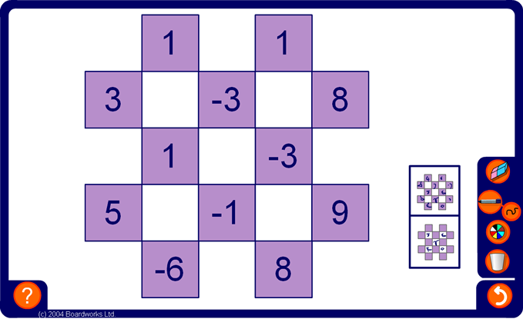
Chequered sums
Notes:
Explain that the numbers in the white squares are equal to the sum of the numbers in the four coloured cells touching them.
Explain clearly how to work out the answer in one of the squares.
Now ask pupils for the number which goes into each square.
Pupils may give their answers using individual white boards or by putting hands up.
Make the activity more difficult by hiding integers in the coloured cells.

Slide 17
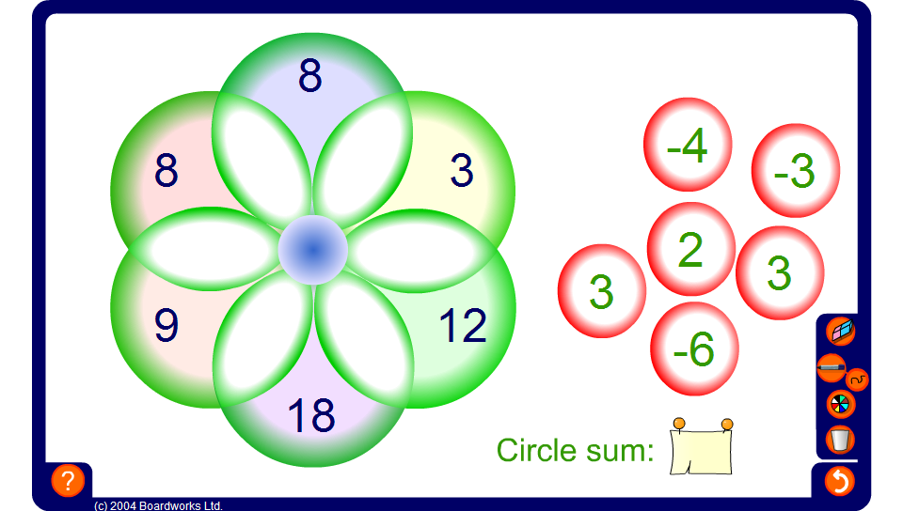
Integer circle sums
Notes:
Select a volunteer to come to the board and drag numbers into the intersections so the the total inside each circle is the same. Members of the class should call out suggestions.
Simplify the problem by revealing the circle sum.

Slide 18
Adding and subtracting integers summary
To add a positive integer we move forwards up the number line.
To add a negative integer we move backwards down the number line.
a + –b is the same as a – b.
To subtract a positive integer we move backwards down the number line.
To subtract a negative integer we move forwards up the number line.
a – –b is the same as a + b.
Notes:
Stress that adding a negative integer is the same as subtracting and that subtracting a negative integer is the same as adding.
Unlike multiplying and dividing integers, when adding and subtracting integers the answer is positive or negative depending on the start number and how much we move up or down the number line.

